Slide 1
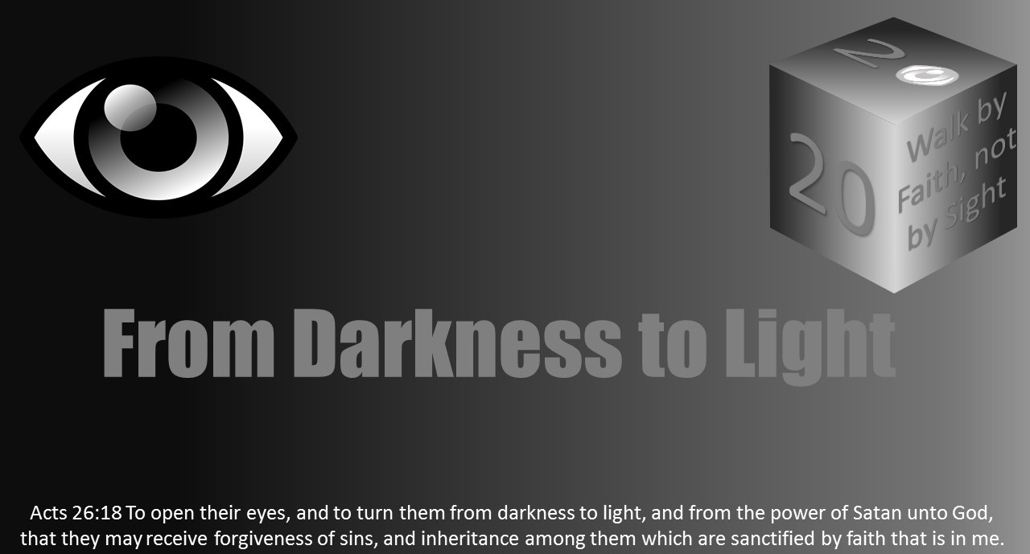


Slide 2

Light Lesson 5
Light to the World
Notes:
2

Slide 3
Introduction
Drivers who notice something in their peripheral vision often suddenly realize they are off the road and moving in the direction of the thing that caught their eyes.
Focus is important. There is power in focusing on a task or problem.
Some folks with Asperger’s Syndrome can hyper-focus on a problem that seems to fail being solved individual who are neurologically typical. At other times, this same group will miss the obvious body language cues that everyone else sees.
Because God is our light, children of the Light must focus on Jesus, fixing their eyes on Him.

Slide 4
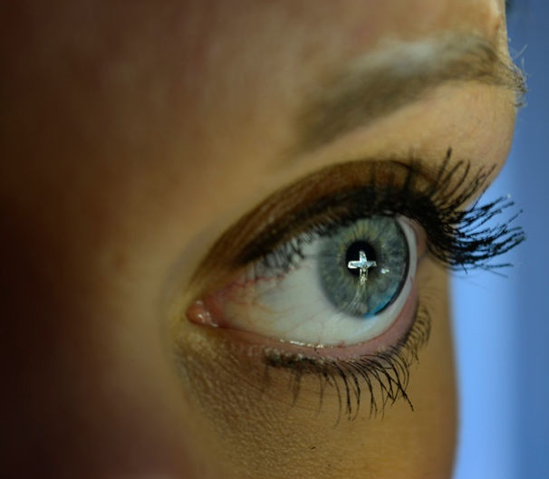
Introduction
Hebrews 12:1-2 encourages: “Therefore we also, since we are surrounded by so great a cloud of witnesses, let us lay aside every weight, and the sin which so easily ensnares us, and let us run with endurance the race that is set before us, looking unto Jesus, the author and finisher of our faith, who for the joy that was set before Him endured the cross, despising the shame, and has sat down at the right hand of the throne of God.”
In verses 3-11, the Hebrews author encourages the reader to endure and appreciate God’s discipline and training “that we may be partakers of His holiness.”
The Hebrews writer continues to encourage the reader to pursue peace and holiness because without it, we will not see the Lord.
The writer continues by instructing to “look carefully” (v15) lest one fall short of the grace of God.
The Hebrew’s scribe fortifies the reader to “see that you do not refuse Him who speaks” from heaven (v25), but “serve God acceptably with reverence and fear” (v26).
Notes:
Hebrews 12
The Race of Faith
¹ Therefore we also, since we are surrounded by so great a cloud of witnesses, let us lay aside every weight, and the sin which so easily ensnares us, and let us run with endurance the race that is set before us, ² looking unto Jesus, the author and finisher of our faith, who for the joy that was set before Him endured the cross, despising the shame, and has sat down at the right hand of the throne of God. The Discipline of God
³ For consider Him who endured such hostility from sinners against Himself, lest you become weary and discouraged in your souls. ⁴ You have not yet resisted to bloodshed, striving against sin. ⁵ And you have forgotten the exhortation which speaks to you as to sons: “ My son, do not despise the chastening of the LORD, Nor be discouraged when you are rebuked by Him; ⁶ For whom the LORD loves He chastens, And scourges every son whom He receives.”^{[a]} ⁷ If^{[b]} you endure chastening, God deals with you as with sons; for what son is there whom a father does not chasten? ⁸ But if you are without chastening, of which all have become partakers, then you are illegitimate and not sons. ⁹ Furthermore, we have had human fathers who corrected us, and we paid them respect. Shall we not much more readily be in subjection to the Father of spirits and live? ¹⁰ For they indeed for a few days chastened us as seemed best to them, but He for our profit, that we may be partakers of His holiness. ¹¹ Now no chastening seems to be joyful for the present, but painful; nevertheless, afterward it yields the peaceable fruit of righteousness to those who have been trained by it. Renew Your Spiritual Vitality
¹² Therefore strengthen the hands which hang down, and the feeble knees, ¹³ and make straight paths for your feet, so that what is lame may not be dislocated, but rather be healed. ¹⁴ Pursue peace with all people, and holiness, without which no one will see the Lord: ¹⁵ looking carefully lest anyone fall short of the grace of God; lest any root of bitterness springing up cause trouble, and by this many become defiled; ¹⁶ lest there be any fornicator or profane person like Esau, who for one morsel of food sold his birthright. ¹⁷ For you know that afterward, when he wanted to inherit the blessing, he was rejected, for he found no place for repentance, though he sought it diligently with tears. The Glorious Company
¹⁸ For you have not come to the mountain that^{[c]} may be touched and that burned with fire, and to blackness and darkness^{[d]} and tempest, ¹⁹ and the sound of a trumpet and the voice of words, so that those who heard it begged that the word should not be spoken to them anymore. ²⁰ (For they could not endure what was commanded: “And if so much as a beast touches the mountain, it shall be stoned^{[e]} or shot with an arrow.”^{[f]} ²¹ And so terrifying was the sight that Moses said, “I am exceedingly afraid and trembling.”^{[g]}) ²² But you have come to Mount Zion and to the city of the living God, the heavenly Jerusalem, to an innumerable company of angels, ²³ to the general assembly and church of the firstborn who are registered in heaven, to God the Judge of all, to the spirits of just men made perfect, ²⁴ to Jesus the Mediator of the new covenant, and to the blood of sprinkling that speaks better things than that of Abel. Hear the Heavenly Voice
²⁵ See that you do not refuse Him who speaks. For if they did not escape who refused Him who spoke on earth, much more shall we not escape if we turn away from Him who speaks from heaven, ²⁶ whose voice then shook the earth; but now He has promised, saying, “Yet once more I shake^{[h]} not only the earth, but also heaven.”^{[i]} ²⁷ Now this, “Yet once more,” indicates the removal of those things that are being shaken, as of things that are made, that the things which cannot be shaken may remain. ²⁸ Therefore, since we are receiving a kingdom which cannot be shaken, let us have grace, by which we may^{[j]} serve God acceptably with reverence and godly fear. ²⁹ For our God is a consuming fire.

Slide 5
Introduction
People can focus on many things in this life.
Satan will supply many dazzling distractions to try and lead us to the darkness.
As Children of the Light, we should fix our attention and focus on Jesus. We must be careful of focusing on worldly treasures or earthy ambitions.
Matthew 6:22-24 teaches, “The light of the body is the eye: if therefore thine eye be single, thy whole body shall be full of light. But if thine eye be evil, thy whole body shall be full of darkness. If therefore the light that is in thee be darkness, how great is that darkness! No man can serve two masters: for either he will hate the one, and love the other; or else he will hold to the one, and despise the other. Ye cannot serve God and mammon.”
Even more important than focusing on the eternal reward God has promised, is the focus on Jesus. He deserves the child of God’s focus. Jesus is worthy, and He can show us how to run the race best.
It is this kind of focus that helps Christians avoid weariness and losing heart. Focusing on and imitating Jesus improves the Child of Light’s ability to cross the finish line as well.
1 Peter 2:21 instructs, “For even hereunto were ye called: because Christ also suffered for us, leaving us an example, that ye should follow his steps.”

Slide 6
Eyes On Our Savior
Jesus Deserves our Focus
1 Peter 2:21
The Benefit of Fixing Our Eyes On Jesus
Focusing Only On The Finish Line Can Be Discouraging.
Focusing On, And Therefore Imitating, The Champion Improves Our Ability To Cross The Finish Line Well.
Notes:
JESUS Deserves our FOCUS: Not our Reward, Not our Earthly Ambitions, Not our Earthly Treasures. JESUS is WORTHY – ONLY JESUS can show us how to to run the race the best.
Verse 3 Benefit: Prevents Weariness & Losing Heart
6

Slide 7
Fixing Our Eyes On Jesus
His Stature – “the author”
His Faith – “perfecter of faith”
His Perspective – “for the joy set before Him”
His Perseverance – “endured the cross”
His Attitude – “despising the shame”
His Reward – “the right hand of the throne”
Notes:
STATURE: See Hebrews 2:10 – Jesus is the very first, the leader, the captain, the inventor of our Christian FAITH.
He Is Our Hero
His Spiritual Fitness
Moral Strength, Heavenly Wisdom, Love For God
The Excellence of His Character
FOCUSING ON JESUS: Shows Me What Excellence looks like in vivid detail and Excites Me About Running As Well As He Ran. It helps me be an excellent Christian – which leads to being a great dad, a great husband, a great employee, a great friend – I don’t have to focus on every individual role I will ever fill in life. I have to focus on JESUS, and as I imitate Him, the way I run my race in every area of life will improve.
FAITH:
He Put God’s Will First In Everything – FULLY Trusted In God’s Plan.
Is God’s Will The Over-riding Ultimate Decision Making Factor In Every Area Of My Life?
FOCUSING ON JESUS: Helps me keep God’s will as priority number one, and demonstrates how reliable God is so that I can rest easy knowing I am doing the right thing.
PERSPECTIVE:
Joy Set Before Him
Jesus knew to put long term benefits before instant gratification.
Jesus knew how to enjoy life’s simple pleasures without laying up His treasure here on earth.
(earnestly desired to share Passover with them)
FOCUSING ON JESUS: Helps me have confidence in the Joys that await me.
PERSEVERANCE:
I Must Persevere when life gets tough (and yes there will be days like that)
Jesus Proves That Perseverance & Hope Are Connected
FOCUSING ON JESUS: Helps me push aside distractions and frustrations of this life as temporary. Helps me see how struggles refine me and help me grow stronger. “James McDonald said it well when he said – “God is not a pampering God – God is a perfecting God.” So I will endure whatever God allows in my life, knowing it further perfects me.
ATTITUDE:
Despising The Shame – looked down in his mind. In His mind he minimized the shame and kept his focus on the SALVATION he was providing to All. To the VICTORY over death he would bring. A great word we use would be “minimize” He gave the shame of the cross minimal attention because He knew greater things were are work.
Jesus did not let the suffering of this world take his heart away from the “weightier matters” as He described them.
Don’t let life’s ups and downs produce resentment against God.
SIN, not God, required Jesus death on the cross.
FOCUSING IN JESUS ATTITUDE: Helps me maintain humility and honor God within my heart and my speech.
REWARD:
He was not disappointed.
Paul echoes the same thoughts to us – knowing we are pressing on for the crown of life for all who have loved His appearing.
FCUSING ON HIS REWARD: Helps me remember that a place is being prepared for me.
*According to the The Universal Jewish Encyclopedia, article on "Marriage," after a groom and bride had been betrothed, the Jewish groom would go and begin preparing a place for the couple to live.
We remember that Under the law of Moses, family property was distributed via the male descendants, so brides were seen primarily as joining the family of the groom. As grooms fulfilled their responsibility to prepare a place, the common practice was to “build an addition” onto their fathers house. A special place where the groom and his bride would share their life. In John 14, when Jesus says “I go to prepare a place for you” He is referencing this cultural practice. He is telling us – I love you, and I am going to go away for a little while to prepare a place, just like any good groom would. But just like every good bride eagerly prepares to join her husband in their special place within “the Father’s house” you prepare yourself to come with me.
Today, we are like that bride – looking out with our EYES fixed on Jesus. Because he has prepared a place for us. And we know it will be a great place…but focus isn’t just on the place. Our focus in on our Savior. He is at the Right Hand of the Father, and He will be back soon for us. So We are preparing ourselves for his imminent arrival.
7

Slide 8
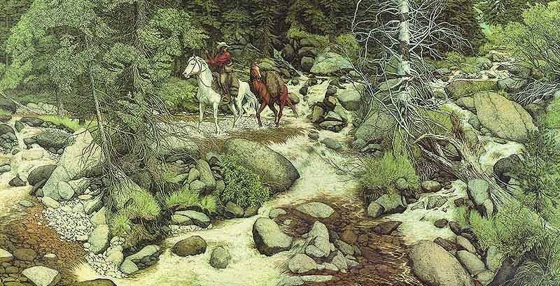
Notes:
Bev Doolittles’ Forest has eyes
Perception and Expectation shape our vision
Can’t see without it
Songs Hold to God’s unchanging hands; Looking to thee
Vision is about perception, expectation, and attention. Perception and expectation shape human vision. One classic illustration of this is the basketball experiment. The experiment consists of two teams. The teams’ leaders suggest those involved might be asked how many times one team passes the ball or loses it to the other side. The action starts, and balls and players are going all around. In the midst of this, a person in a gorilla suit passes through the scene. Most people never see the gorilla and deny it was there until they see it in a replay. Funny how attention and focus change vision or perception.
Another example is this picture below. As a child, I looked at this every morning in my parent’s home. The artist is Bev Doolittle. What do you see? It is just a guy on a horse coming out of the forest, right? The title of the work is “The Forest Has Eyes.” How many faces can you find? Some might think initially… at least in the mid-teens.

Slide 9

Eternal Heart Blindness
Seeing the Unseen
2 Corinthians 4:18
we do not look at the things which are seen, but at the things which are not seen. For the things which are seen are temporary, but the things which are not seen are eternal.
Notes:
The goal of this lesson is to encourage Christians in their walk in the light of God, and for those who need it a good swift, spiritual kick to the head that alters their reality forever. Christians need to think about seeing the unseen. This starts with deciding to change the expectation and attention of perception. 2 Corinthians 4:18 reads, “we do not look at the things which are seen, but at the things which are not seen. For the things which are seen are temporary, but the things which are not seen are eternal. “

Slide 10
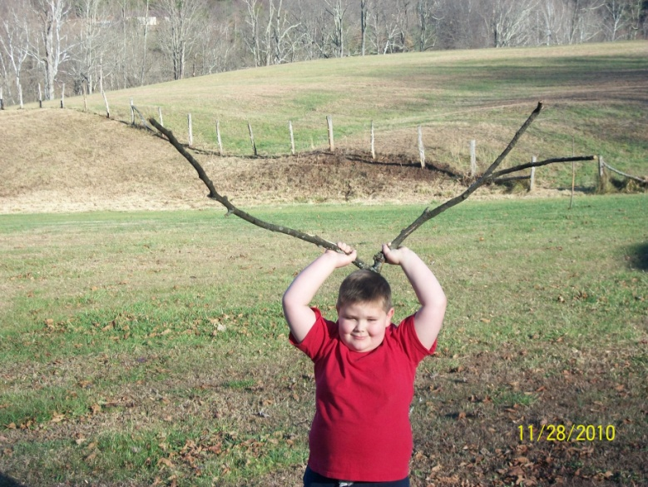
Seeing and Vision
People of vision
Vision and eyesight
Eyewitness examples
See with brain (Filter)
Vision disease
Focus is key
Notes:
Generally, humans are people of vision and eyesight. Eyes and vision guide most in the world. Those who are blind are treated very differently. However, the human brain with the aid of the eyes is what allows us to see. The human brain takes the information provided by the eyes and interprets it to allow a person to see. This involves memory and attention. A person who has never seen a rose might be able to visualize an object without ever having seen it previously. Humans learn to see as children. The brain acts like an interpreting and filtering device. Most of the time, humans have a wide field of view, but often attend to only a portion of what their eyes see. This is focus.
A classic example comes from radiologists. These medical professionals spend years training their eyes and brains to recognize normal and abnormal conditions in the human body seen through various modalities of medical imaging. One study took the opportunity of instructing doctors to look for a specific medical problem in radiographic images. Some had the medical problem quietly hidden in them, and some did not. The analysis showed the medical professional got the diagnosis for each case right in almost all the cases. However, 83% did NOT see the added gorilla placed in the image for the experiment. Expectation and attentiveness for something can cause us to miss something else. (For this and previous gorilla passing through players example see www.npr.org/sections/health-shots/2013/02/11/171409656/why-even-radiologists-can-miss-a-gorilla-hiding-in-plain-sight).
In short, there is a difference between vision and eyesight. Humans in court often have higher trust in eyewitness testimony, but as video reviewed cases have illustrated, details are often lost on eyewitnesses. Thus, perception and focus (and memory) are tricky. Perception tricks, coupled with rampant spiritual eye disease, has used sin to blind the hearts of many and can make it difficult for others to see the eternal or focus on Jesus. Focus is the key.
To illustrate, we might consider an example of four siblings. Three decide to prank the fourth sibling, whose name is Leroy. Leroy is up first working on the family farm to stoke the boiler and fill the coal bin. He is having a good day. However, his brothers have plotted against him. Leroy’s oldest brother asks, "Leroy, are you ok?” "Sure." "Boy, you sure don't look ok? Sure, you ain’t sick? You look awful peeked?" "Really?" Twenty minutes later, as Leroy crosses paths with his next brother, he was completing his chore of watering the seedlings. "Leroy, what's wrong with you?" "Nothing," Leroy responded. "Man, you look horrible, like you've been puking." "Well, I guess I have been busy today.” Brother three was working with Leroy on a chore fifteen minutes later cleaning up some trash and loading it onto a wagon. “Leroy, I can get this if you need to take a break because you look dog sick." "Well, I am feeling rough." Another cycle with the three brothers and Leroy was indeed sick before the call of their mother to lunch. In a matter of minutes, his brother had talked their healthy teenage brother into illness. He was not able to eat lunch and was regurgitating before he made it into the house. In this case, the mischievous power of suggestion caused Leroy to focus his attention and thoughts on how sick he was. The point is focus can yield enough attention to make something a reality, even though a falsehood initially. Perception is tricky, and focus is key.

Slide 11
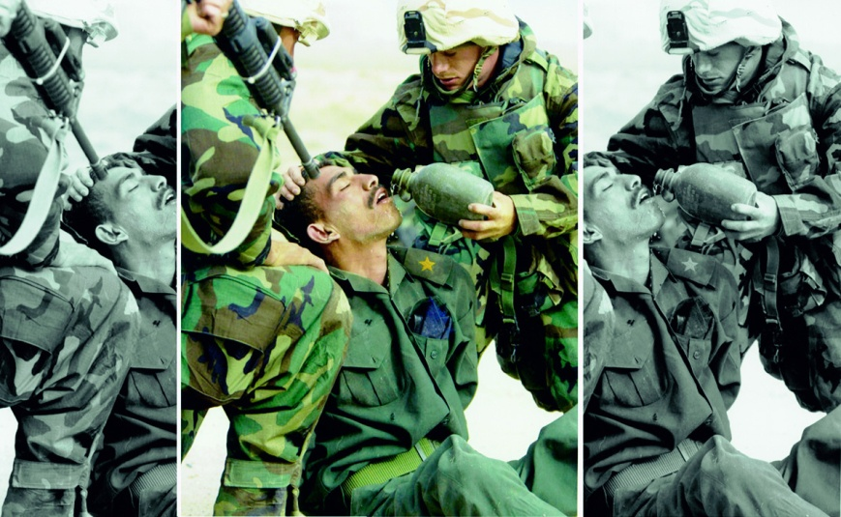
What do you see?
Man be held at gunpoint?

Slide 12
What do you see?
Man being helped?

Slide 13
What do you see?
Notes:
Media Manipulation
Field of view
Depth of field
Consider this classic example of three soldiers. What do you see? Is this a man being held at gunpoint? Or, is this a man being helped? Is this just media manipulation from decades in the past? When we crop a portion of the field of view, the image can be used to tell two different stories. This process of image manipulation has been in use for a long time. We see with the brain, so the brain is filling in lots of gaps. Focus is key to what we see and where we are going. Thus, perception is like many other things where input equals output. Garbage in is garbage out.

Slide 14
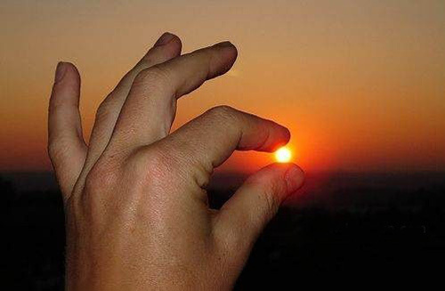
Notes:
Illusion

Slide 15
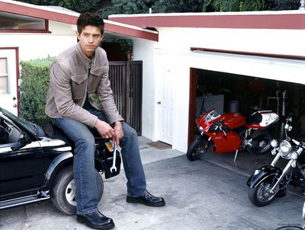
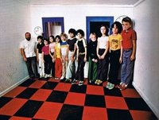

Slide 16
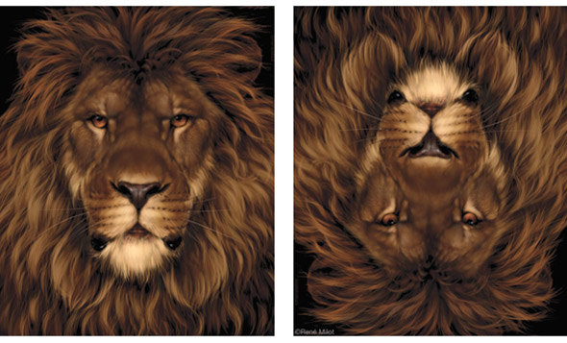
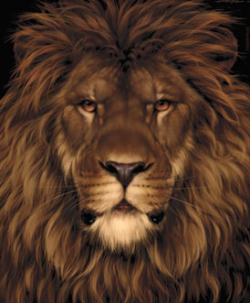

Slide 17

Notes:
See with brain – fills in gap
Focus is key to what we see and where we are going
Input=out[put
Input garbage – garbage out
What do we put in our heart?
Mk 7:21-22

Slide 18
Heart is Source
Mk 7:21-23 For from within, out of the heart of men, proceed evil thoughts, adulteries, fornications, murders, ²² Thefts, covetousness﻿﻿, wickedness, deceit, lasciviousness, an evil eye, blasphemy, pride, foolishness: ²³ All these evil things come from within, and defile the man.
Notes:
Focus becomes or at least greatly impacts output
What do we allow to be put in our heart? Matthew 7:21-23 teaches, "For from within, out of the heart of men, proceed evil thoughts, adulteries, fornications, murders, Thefts, covetousness, wickedness, deceit, lasciviousness, an evil eye, blasphemy, pride, foolishness: All these evil things come from within, and defile the man." Focus greatly impacts output.

Slide 19
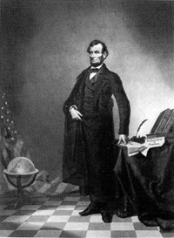
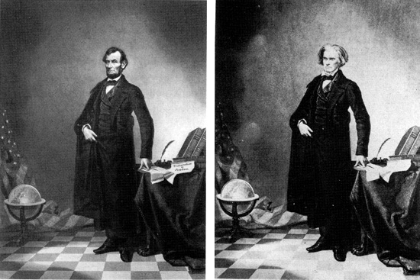
Notes:
circa 1860: This nearly iconic portrait (in the form of a lithograph) of U.S. President Abraham Lincoln is a composite of Lincoln's head and the Southern politician John Calhoun's body

Slide 20
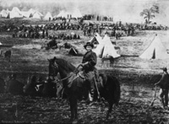
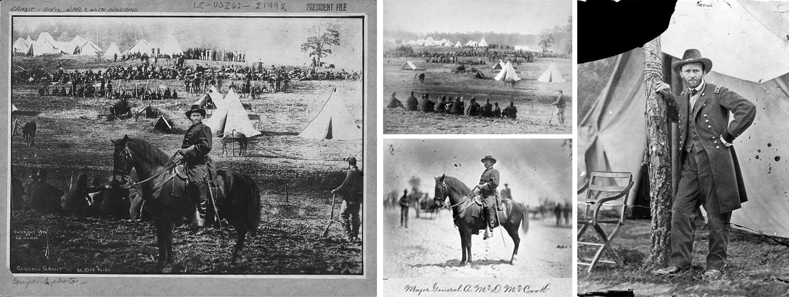
Notes:
circa 1864: This print purports to be of General Ulysses S. Grant in front of his troops at City Point, Virginia, during the American Civil War.
the head in this photo is taken from a portrait of Grant; (
2) the horse and body are those of Major General Alexander M. McCook; and (
3) the background is of Confederate prisoners captured at the battle of Fisher's Hill, VA.
Lest we think image manipulation is new, we might consider some older examples. This nearly iconic picture from around 1860 in the form of a lithograph of U.S. President Abraham Lincoln is a composite of Lincoln's head and the Southern politician John Calhoun's body. This second print from around 1864 purports to be of General Ulysses S. Grant in front of his troops at City Point, Virginia, during the American Civil War. The head in this photo is taken from a portrait of Grant while the horse and body are those of Major General Alexander M. McCook. The background is of Confederate prisoners captured at the battle of Fisher's Hill, VA. Yes, the images, as well as, what our attention is drawn to has long been manipulated by depth of field, focus, and filters in photography. What should be the Christian’s focus?

Slide 21
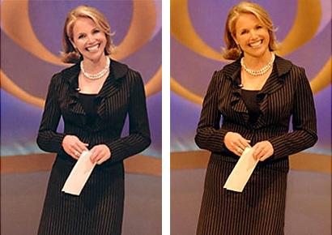

Slide 22
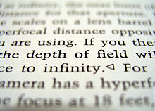
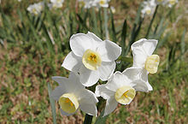

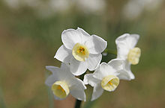

Slide 23



Slide 24
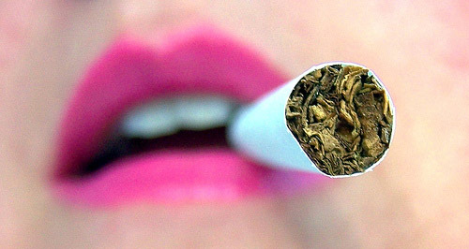

Slide 25


Slide 26


Slide 27


Slide 28
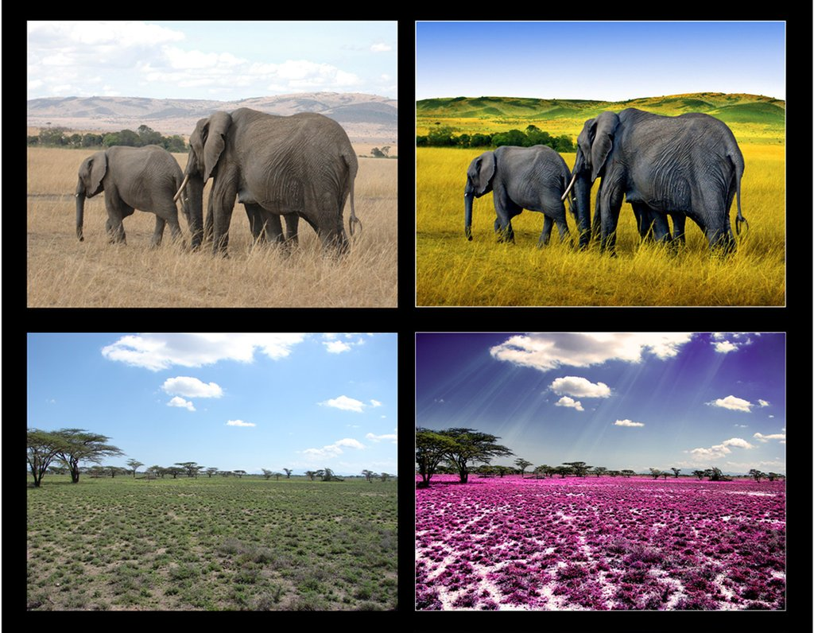

Slide 29
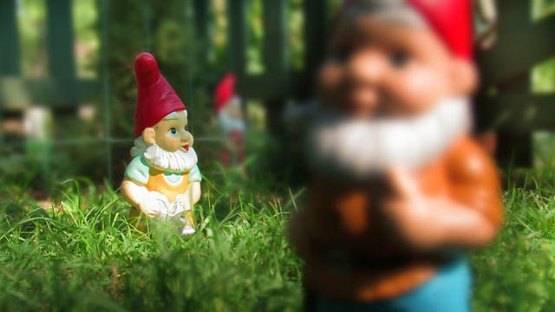
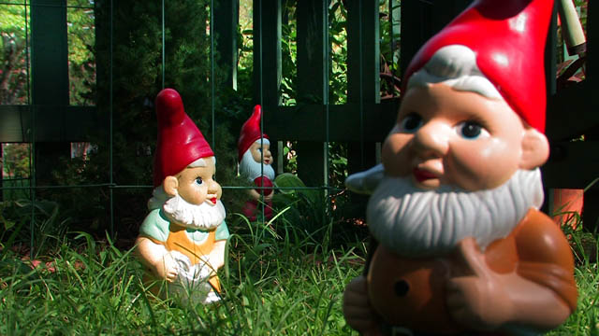

Slide 30
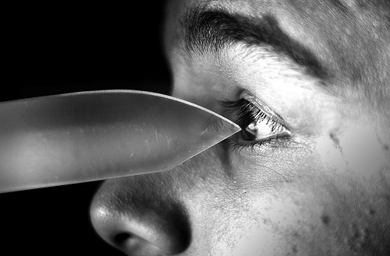

WHAT IS YOUR FOCUS?
10 (two)
Notes:
Point: Vision is our great guide, but vision can be misfocused or manipulated; convinced often misfocused
We must be careful of depending on our eyes. There is a way that seems right to a man, but the ends are death (Prov 14:17; 16:25). Christians have to learn not to trust their eyes, but have faith in God and His righteousness. Thus, Children of the Light walk by faith and not by sight. Yes, vision is the great guide for many tasks, but vision can be misfocused or manipulated; or even convinced to be misfocused.
This author’s friend, Bob, was twice the author’s age when they met, and he often would remark on something as one way or another. His world was largely binary. As Bob used to argue, many things come down to one case or the other. As the old binary joke goes, there are only 10(two) kinds of people in the world. For example, the baby is or is not due in March. So much of the time, life is one of two options. In this existence, there are really two mindsets. That is not to say a person who has one mindset does not dabble or fall into the other at times. A person is either about self or selflessness. A person is either carnal (fleshly minded) or spiritual (eternally minded).

Slide 31


Slide 32

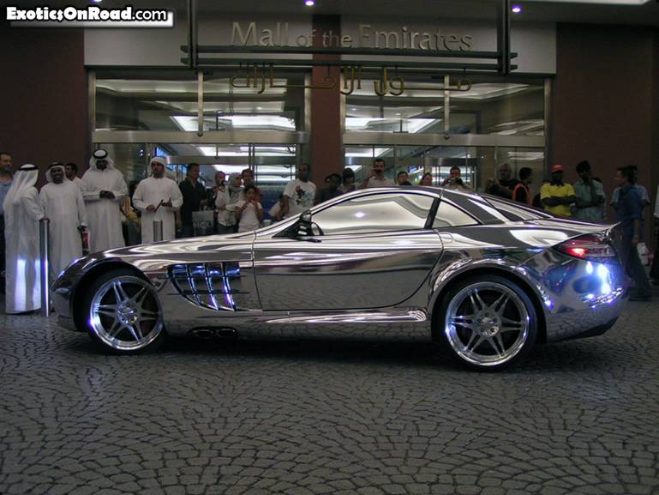
Self Focused
Pleasure/Carnal
Sin
Temporary
Results in heart Blindness
Self Focused
Pleasure/Carnal
Sin
Temporary
Results in heart Blindness
Notes:
The carnal can make us feel smart, enlightened, educated, or whatever; but like sin it is a deceiver.
The carnal can make us feel puffed up. (Which causes folks to start talking about things which they are ignorant).
The carnally minded person can be very wise from a worldly perspective – many are. The carnally minded person is usually focused on self.
That does not mean they are completely incapable, caring for others, or even helping and doing for others,;but ultimately, they are about “me.”
When their desires of the flesh, lust of the eyes, or pride is not met, then things break down. Often, for many who are carnally minded, they never change over for striving for empty, vain things. It is about the boat, the house, the fancy gadget, celebrity, or whatever. It is the keeping up with the Jones mindset.

Slide 33
1 Corinthians 1:18-24
¹⁸ For the preaching of the cross is to them that perish foolishness; but unto us which are saved it is the power of God. ¹⁹ For it is written, I will destroy the wisdom of the wise, and will bring to nothing the understanding of the prudent. ²⁰ Where is the wise? where is the scribe? where is the disputer of this world? hath not God made foolish the wisdom of this world? ²¹ For after that in the wisdom of God the world by wisdom knew not God, it pleased God by the foolishness of preaching to save them that believe. ²² For the Jews require a sign, and the Greeks seek after wisdom: ²³ But we preach Christ crucified, unto the Jews a stumblingblock, and unto the Greeks foolishness; ²⁴ But unto them which are called, both Jews and Greeks, Christ the power of God, and the wisdom of God. ²⁵ Because the foolishness of God is wiser than men; and the weakness of God is stronger than men.
Notes:
¹⁸ For the preaching of the cross is to them that perish foolishness; but unto us which are saved it is the power of God. ¹⁹ For it is written, I will destroy the wisdom of the wise, and will bring to nothing the understanding of the prudent. ²⁰ Where is the wise? where is the scribe? where is the disputer of this world? hath not God made foolish the wisdom of this world? ²¹ For after that in the wisdom of God the world by wisdom knew not God, it pleased God by the foolishness of preaching to save them that believe. ²² For the Jews require a sign, and the Greeks seek after wisdom: ²³ But we preach Christ crucified, unto the Jews a stumblingblock, and unto the Greeks foolishness; ²⁴ But unto them which are called, both Jews and Greeks, Christ the power of God, and the wisdom of God. ²⁵ Because the foolishness of God is wiser than men; and the weakness of God is stronger than men.
Satan often uses people, places, and things to change our focus. Satan is particularly good at changing labels and price tags while manipulating people's perspective.
I first heard this expression from Mark Childers, a member where I attend church.

Slide 34

Self Focused
Pleasure/Carnal
Sin
Temporary
Results in heart Blindness
Self Focused
Pleasure/Carnal
Sin
Temporary
Results in heart Blindness
Notes:
There is often a progression to this carnal mindset.
They never reach beyond self, and their eternal viewpoint or understanding is darkened.
They never add any truth about the eternal.
In their ignorance, lasciviousness grows into a life of uncleanness with a never satisfied greed.
Their heart is hardened to seeing anything which is eternal minded or spiritually minded as valuable.
This is in the extreme, but too common. The result is the blindness of carnality, blindness of the heart to eternity,

Slide 35
Romans 1:19-24
¹⁹ Because that which may be known of God is manifest in them﻿; for God hath shewed it unto them. ²⁰ For the invisible things of him from the creation of the world are clearly seen, being understood by the things that are made, even﻿﻿ his eternal power and Godhead; so﻿﻿ that they are without excuse: ²¹ Because that, when they knew God, they glorified him not as God, neither were thankful; but became vain in their imaginations, and their foolish heart was darkened. ²² Professing themselves to be wise, they became fools, ²³ And changed the glory of the uncorruptible God into an image made like to corruptible man, and to birds, and fourfooted beasts, and creeping things. ²⁴ Wherefore God also gave them up to uncleanness through the lusts of their own hearts, to dishonour their own bodies between themselves
Notes:
¹⁹ Because that which may be known of God is manifest in them﻿^{f}﻿; for God hath shewed it unto them. ²⁰ For the invisible things of him from the creation of the world are clearly seen, being understood by the things that are made, even﻿†﻿ his eternal power and Godhead; so﻿^{g}﻿ that they are without excuse: ²¹ Because that, when they knew God, they glorified him not as God, neither were thankful; but became vain in their imaginations, and their foolish heart was darkened. ²² Professing themselves to be wise, they became fools, ²³ And changed the glory of the uncorruptible God into an image made like to corruptible man, and to birds, and fourfooted beasts, and creeping things. ²⁴ Wherefore God also gave them up to uncleanness through the lusts of their own hearts, to dishonour their own bodies between themselves: ^{f}

Slide 36
Ephesians 4:17-19
This I say therefore, and testify in the Lord, that ye henceforth walk not as other Gentiles walk, in the vanity of their mind, ¹⁸ Having the understanding darkened, being alienated from the life of God through the ignorance that is in them, because of the blindness﻿ of their heart: ¹⁹ Who being past feeling have given themselves over unto lasciviousness, to work all uncleanness with greediness. ^{e}blindness: or, hardness
Notes:
Progression of carnal mind Eph 4:17-19
We must ask: What does or could Satan use to blind me or change my focus from the Christ?

Slide 37
2 Corinthians 4:3-4
But if our gospel be hid, it is hid to them that are lost: ⁴ In whom the god of this world hath blinded the minds of them which believe not, lest the light of the glorious gospel of Christ, who is the image of God, should shine unto them.
Notes:
Progression of the carnal or temporal or self focused mind
2 Cor 4:3-4 Blinded by world to gospel
v.6 God sent the light
v.16 otuward perish inward renewed (re make afresh by God’s word)
v.17-18 See the Unseen
5:1-10 Big picture

Slide 38
2 Corinthians 4:5-6
For we preach not ourselves, but Christ Jesus the Lord; and ourselves your servants for Jesus’ sake. ⁶ For God, who commanded the light to shine out of darkness, hath shined in our hearts, to give the light of the knowledge of the glory of God in the face of Jesus Christ.
Notes:
Progression of the carnal or temporal or self focused mind
2 Cor 4:3-4 Blinded by world to gospel
v.6 God sent the light
v.16 otuward perish inward renewed (re make afresh by God’s word)
v.17-18 See the Unseen
5:1-10 Big picture

Slide 39
2 Corinthians 4:16-18
¹⁶ For which cause we faint not; but though our outward man perish, yet the inward man is renewed day by day. ¹⁷ For our light affliction, which is but for a moment, worketh for us a far more exceeding and eternal weight of glory; ¹⁸ While we look not at the things which are seen, but at the things which are not seen: for the things which are seen are temporal; but the things which are not seen are eternal.
Notes:
Progression of the carnal or temporal or self focused mind
2 Cor 4:3-4 Blinded by world to gospel
v.6 God sent the light
v.16 otuward perish inward renewed (re make afresh by God’s word)
v.17-18 See the Unseen
5:1-10 Big picture
¹ For we know that if our earthly house of this tabernacle were dissolved, we have a building of God, an house not made with hands, eternal in the heavens. ² For in this we groan, earnestly desiring to be clothed upon with our house which is from heaven: ³ If so be that being clothed we shall not be found naked. ⁴ For we that are in this tabernacle do groan, being burdened: not for that we would be unclothed, but clothed upon, that mortality might be swallowed up of life. ⁵ Now he that hath wrought us for the selfsame thing is God, who also hath given unto us the earnest of the Spirit. ⁶ Therefore we are always confident, knowing that, whilst we are at home in the body, we are absent from the Lord: ⁷ (For we walk by faith, not by sight:) ⁸ We are confident, I say, and willing rather to be absent from the body, and to be present with the Lord. ⁹ Wherefore we labour﻿ª﻿, that, whether present or absent, we may be accepted of him. ¹⁰ For we must all appear before the judgment seat of Christ; that every one may receive the things done in his body, according to that he hath done, whether it be good or bad

Slide 40
2 Corinthians 5:1-10
2 Corinthians 5:1-10 “For we know that if our earthly house of this tabernacle were dissolved, we have a building of God, an house not made with hands, eternal in the heavens. For in this we groan, earnestly desiring to be clothed upon with our house which is from heaven: If so be that being clothed we shall not be found naked. For we that are in this tabernacle do groan, being burdened: not for that we would be unclothed, but clothed upon, that mortality might be swallowed up of life. Now he that hath wrought us for the selfsame thing is God, who also hath given unto us the earnest of the Spirit. Therefore we are always confident, knowing that, whilst we are at home in the body, we are absent from the Lord: (For we walk by faith, not by sight:) We are confident, I say, and willing rather to be absent from the body, and to be present with the Lord. Wherefore we labour, that, whether present or absent, we may be accepted of him. For we must all appear before the judgment seat of Christ; that every one may receive the things done in his body, according to that he hath done, whether it be good or bad.”
Notes:
Paul now gives the reader the big picture in 2 Corinthians 5:1-10 “For we know that if our earthly house of this tabernacle were dissolved, we have a building of God, an house not made with hands, eternal in the heavens. For in this we groan, earnestly desiring to be clothed upon with our house which is from heaven: If so be that being clothed we shall not be found naked. For we that are in this tabernacle do groan, being burdened: not for that we would be unclothed, but clothed upon, that mortality might be swallowed up of life. Now he that hath wrought us for the selfsame thing is God, who also hath given unto us the earnest of the Spirit. Therefore we are always confident, knowing that, whilst we are at home in the body, we are absent from the Lord: (For we walk by faith, not by sight:) We are confident, I say, and willing rather to be absent from the body, and to be present with the Lord. Wherefore we labour, that, whether present or absent, we may be accepted of him. For we must all appear before the judgment seat of Christ; that every one may receive the things done in his body, according to that he hath done, whether it be good or bad.” In the big picture, it is the eternal and not the now. Because humans have such a dependence on vision, Paul admonishes to walk by faith and not by sight.
A very young proofreader commented on this paragraph, "Just like Star Wars.” Obi-wan Kenobi encouraged his young learner in the movie "Your eyes can deceive you. Don't trust them.” Christians must be aware that trusting their eyes with the temporal can be dangerous. They must use an eternal prism or a lens of faith to walk by faith and not by sight. Optometrists often use prism in lenses to move an image to an eye when the eyes cannot align together naturally. The prism of eternity is thus a lens that allows the spiritually minded person to move the eternal into their view.

Slide 41
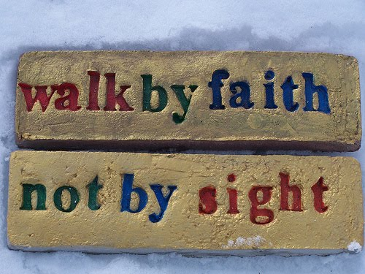
Notes:
Some still grope at the idea of something more but are like brute beasts as Jude discusses.
They cling to some guru or some organization.
Their sense of the eternal is minimal at best.
When I see the convict come in for care with the handcuffs, waist chain, and ankle chains with four guards, this is a person who only understands by the brutal.
Most of humanity never sinks this low, but often are still bound by the chains of sin.
The carnally minded must be reminded that the ultimate absolute statistic is death or Christ return followed by judgment.
For the carnally minded person to change, they have to focus on the eternal and others rather than self – done thru word.

Slide 42
Eccl 12:13-14
¹³ Let us hear the conclusion of the whole matter: Fear God, and keep his commandments: for this is the whole duty of man. ¹⁴ For God shall bring every work into judgment, with every secret thing, whether it be good, or whether it be evil.
Notes:
Solomon in all his wisdom, fame, and wealth tried whatever his desire under the sun (horizontal relationship) – labor, wine, women, mirth, and song.
Yet, in the end, he recognized that it was all vanity except for the vertical relationship with God.
Eccl 12:13-14 ¹³ Let us hear the conclusion of the whole matter: Fear God, and keep his commandments: for this is the whole duty of man. ¹⁴ For God shall bring every work into judgment, with every secret thing, whether it be good, or whether it be evil.

Slide 43
Notes:
Wide path or narrow path
Simple

Slide 44
Turned Focus
Our focus and attention can easily be distracted in the physical, as well as the spiritual.
In Luke 9:62, Jesus warns, “No man, having put his hand to the plough, and looking back, is fit for the kingdom of God.”
Peter illustrates this point well when he was called by Christ to walk out to Him on the water. Peter’s focus on Christ was distracted by the storm.
Matthew 14:29-31 details, “And he said, Come. And when Peter was come down out of the ship, he walked on water, to go to Jesus. But when he saw the wind boisterous, he was afraid; and beginning to sink, he cried, saying, Lord, save me. And immediately Jesus stretched forth his hand, and caught him, and said unto him, O thou of little faith, wherefore didst thou doubt?”
Yes, it is easy to allow our focus to be turned from Jesus.
Notes:
Our focus and attention can easily be distracted in the physical, as well as the spiritual. In Luke 9:62, Jesus warns, “No man, having put his hand to the plough, and looking back, is fit for the kingdom of God.” Peter illustrates this point well when he was called by Christ to walk out to Him on the water. Peter’s focus on Christ was distracted by the storm. Matthew 14:29-31 details, “And he said, Come. And when Peter was come down out of the ship, he walked on water, to go to Jesus. But when he saw the wind boisterous, he was afraid; and beginning to sink, he cried, saying, Lord, save me. And immediately Jesus stretched forth his hand, and caught him, and said unto him, O thou of little faith, wherefore didst thou doubt?” Yes, it is easy to allow our focus to be turned from Jesus.

Slide 45

Other Focused
Glorifying God
Heaven
Results values different in carnal
Puts off lust, on holiness
Notes:
The spiritual minded person realizes their dependence upon God.
Ultimately, they look to the eternal in all of life.
They recognize God’s grace and favor.
This does not mean they are not tempted by the lust of the flesh, the lust of the eyes, or the pride of life.
Most spiritually minded folks that I know have been quagmired by these things at some point in their lives.
And, too often have been again ensnared by them.
Most of us have been attracted to some flashy trinket or important care of this life.
The spiritually minded understand that through Christ they have thrown off the cruelty of deceptive carnality.
Their focus is changed to caring for others, glorifying God, and on heaven as they focus on the Christ. This requires putting off the corruption that is in the world through lust and putting on holiness as Children of the Light. This results in values very different than the carnally minded, as such people have an eye of faith looking to the things not seen. The spiritually minded person seeks the eternal. The spiritually minded live this life by striving for purity, serving in humble unselfishness, and giving agape love.

Slide 46
Hebrews 11:10
Abraham in Heb 11:10 For he looked for a city which hath foundations, whose builder and maker is God.
Hebrews 11:16 But now they desire a better country, that is, an heavenly: wherefore God is not ashamed to be called their God: for he hath prepared for them a city
Notes:
The Eye of Faith Sees the Unseen
Pursuit of Holiness: Defocusses the Temporal to focus on the Eternal
Abraham in Heb 11:10 For he looked for a city which hath foundations, whose builder and maker is God.
Heroes of faith Hebrews 11:16 But now they desire a better country, that is, an heavenly: wherefore God is not ashamed to be called their God: for he hath prepared for them a city
Blind or ignore to the glitter and bells and whitsles of sin
Embrace the intentionally forgetful love of the Father

Slide 47
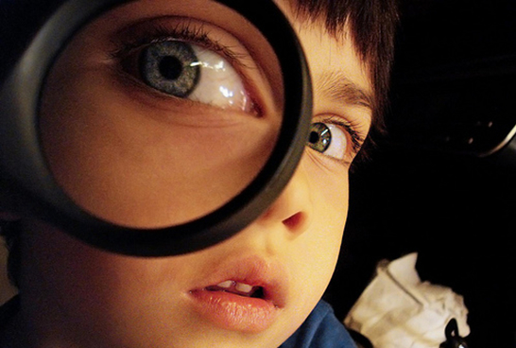
Hebrews 12:1-2
Wherefore seeing we also are compassed about with so great a cloud of witnesses, let us lay aside every weight, and the sin which doth so easily beset us, and let us run with patience the race that is set before us, ² Looking unto Jesus the author﻿﻿ and finisher of our faith; who for the joy that was set before him endured the cross, despising the shame, and is set down at the right hand of the throne of God.
Notes:
The Eye of Faith Sees the Unseen
Pursuit of Holiness: Defocusses the Temporal to focus on the Eternal
Focuses on Christ
Wherefore seeing we also are compassed about with so great a cloud of witnesses, let us lay aside every weight, and the sin which doth so easily beset us, and let us run with patience the race that is set before us, ² Looking unto Jesus the author﻿﻿ and finisher of our faith; who for the joy that was set before him endured the cross, despising the shame, and is set down at the right hand of the throne of God.

Slide 48
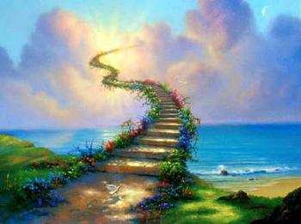
Other Focused
Glorifying God
Heaven
Results values different in carnal
Puts off lust, on holiness
Notes:
In a way that the carnally minded person cannot understand, the spiritually minded find happiness and peace (David) in the hope of the eternal.
Nothing else is satisfactory to the spiritually minded person.
Politicians lie and fail. Economics rise and collapse. Leaders come and go.
To the carnal mind, this is silliness or foolishness.
To the enlightened and educated carnal mind, the spiritually minded person of faith is creating deity in their mind.
However, for the spiritual person, faith is the substance of things hoped for and the evidence of things not seen. Heb 11:1
Renew in mind by inputting God’s word. Glorifying His name is the spiritually minded person’s focus. It is not about me or you – it is about God.

Slide 49
Galatians 2:20
I am crucified with Christ: nevertheless I live; yet not I, but Christ liveth in me: and the life which I now live in the flesh I live by the faith of the Son of God, who loved me, and gave himself for me.
Notes:
The spiritually minded person makes serving and glorifying God the center of their lives.
The mindset is not that Christ is their first priority or the biggest piece of the pie of life, but rather that He encompasses all of life.
He is the center cog on which all else moves and exists.
It is not I who live, but Christ who lives in me. It is not about me or self.
I have given up my rights that I may serve Jehovah. This is contrary to a self and rights driven culture.
This is the progression or transformation of the selfless and spiritually minded person, at war with the flesh toward holiness.

Slide 50
2 Peter 1:3-4
According as his divine power hath given unto us all things that pertain unto life and godliness, through the knowledge of him that hath called us to﻿ glory and virtue: ⁴ Whereby are given unto us exceeding great and precious promises: that by these ye might be partakers of the divine nature, having escaped the corruption that is in the world through lust.
Notes:
DIVINE NATURE: According as his divine power hath given unto us all things that pertain unto life and godliness, through the knowledge of him that hath called us to﻿ glory and virtue: ⁴ Whereby are given unto us exceeding great and precious promises: that by these ye might be partakers of the divine nature, having escaped the corruption that is in the world through lust
This is the progression or transformation of the selfless and spiritually minded person, at war with the flesh toward holiness.

Slide 51
1 Peter 1:14-16
¹⁴ As obedient children, not fashioning yourselves according to the former lusts in your ignorance: ¹⁵ But as he which hath called you is holy, so be ye holy in all manner of conversation; ¹⁶ Because it is written, Be ye holy; for I am holy.
Notes:
As Pursuit or Transformation to Holiness: As obedient children, not fashioning yourselves according to the former lusts in your ignorance: ¹⁵ But as he which hath called you is holy, so be ye holy in all manner of conversation; ¹⁶ Because it is written, Be ye holy; for I am holy
This is the progression or transformation of the eternally minded person, at war with the flesh toward holiness.
Transformation Rom 12:1-2
Holinesss 1 Thes 4:7
Divine Nature 1 Peter 1:14-15

Slide 52

1 Thes 4:7
⁷ For God hath not called us unto uncleanness, but unto holiness.
Notes:
This is the progression or transformation of the selfless and spiritually minded person, at war with the flesh toward holiness.
Transformation Rom 12:1-2
Holinesss 1 Thes 4:7
Divine Nature 1 Peter 1:14-15
Focus on Christ, pursue holiness, be partaker of Divine nature Transform

Slide 53
Carnal
Self Focused
Pleasure/Carnal
Sin
Temporary
Results in heart Blindness
Spiritual
Other Focused
Glorifying God
Heaven
Results values different in carnal
Puts off lust, on holiness
Notes:
Transformative Romans 12:1-2

Slide 54
2 Corinthian 10:3-5
For though we walk in the flesh, we do not war after the flesh: ⁴ (For the weapons of our warfare are not carnal, but mighty through God to the pulling down of strong holds;) ⁵ Casting down imaginations﻿, and every high thing that exalteth itself against the knowledge of God, and bringing into captivity every thought to the obedience of Christ
Notes:
For though we walk in the flesh, we do not war after the flesh: ⁴ (For the weapons of our warfare are not carnal, but mighty through God to the pulling down of strong holds;) ⁵ Casting down imaginations﻿, and every high thing that exalteth itself against the knowledge of God, and bringing into captivity every thought to the obedience of Christ
Christians are partakers of divine holiness (Heb 12:10) and should perfect holiness (2 Cor 7:1). Each of these portions of God's word calls on the Children of the Light to put off lust and on holiness. This is the warfare in which Christians engage: 2 Corinthians 10:3-5 explains, "For though we walk in the flesh, we do not war after the flesh: (For the weapons of our warfare are not carnal, but mighty through God to the pulling down of strong holds;) Casting down imaginations, and every high thing that exalteth itself against the knowledge of God, and bringing into captivity every thought to the obedience of Christ.” This is why children of God focus on Christ – to see the eternal and perfect holiness in their lives.

Slide 55
What is your Focus? Has the temporal/carnal/flesh blinded your heart to the eternal? Are you progressing toward blindness and having your understanding darkened? Have you defocused the flesh and seek the spiritual and eternal? Are you putting off lust and transforming toward holiness? Won’t you seek God?
Notes:
The spiritually minded person must recognize their need to help and serve others. Too often, the spiritually oriented person falls off that trail as they are drawn in by the desires of the flesh and of self. This does not mean that the spiritually minded person has no physical activities or desires. Or that the flesh is evil. People eat, marry, have children, raise families, grow, sow, reap, and so forth. The spiritually minded walk in the flesh, but they do not war after it – that is the distinction. Their goal is eternity in heaven in the long run, and obedience to God and service in glorifying His name in the shorter term.
What is your Focus? Has the temporal/carnal/flesh blinded your hearT to the eternal? Are you progressing toward blindness and having your understanding darkened? Have you defocused the flesh and seek the spiritual and eternal? Are you putting off lust and transforming toward holiness? Build on Christ. Focus on Jesus and eternal.
Won’t you seek God? Despite my sin and failings, I seek to be spiritually minded. Would you join me?
******************************
With confidence in God's promises, Christians change. The process starts with the confession of sins and temptations to others who can help. This requires an honest inventory of self. Further, we must be convicted of the seriousness of our sin and the need to be free of it. As we continue to surrender our life to God's instruction, we continue to grow in our transformation as a Child of Light. This should compel the Christian to share the love of God's gospel with others.
The spiritually minded person must recognize their need to help and serve others. Too often, the spiritually oriented person falls off that trail as they are drawn in by the desires of the flesh and of self. This does not mean the spiritually minded person has no physical activities or desires. Or that the flesh is inherently evil. People eat, marry, have children, raise families, grow, sow, reap, and so forth. The spiritually minded are no different as they walk in the flesh, but they do not war after it – that is the distinction. They see the unseen, the eternal. Their goal is an eternity in heaven in the long run, and obedience to God and service in glorifying His name in the shorter term. They focus on Jesus.

Slide 56
Conclusion
The children of the Light have a different perspective than the natural human.
The Christian renews their minds from God’s instruction.
This allows them to use the prism of eternity and an eye of faith to see spiritual things.
They understand God has prepared for them. 1 Corinthians 2:9 and 13-14 explain, “But as it is written, Eye hath not seen, nor ear heard, neither have entered into the heart of man, the things which God hath prepared for them that love him…Which things also we speak, not in the words which man's wisdom teacheth, but which the Holy Ghost teacheth; comparing spiritual things with spiritual. But the natural man receiveth not the things of the Spirit of God: for they are foolishness unto him: neither can he know them, because they are spiritually discerned.”
Notes:
The Children of the Light have a different perspective than the natural human. They seek to build a life on the eternally significant, pleasing God, living with a perception of the eternal which the natural person cannot see as anything but foolish. The Christian renews their minds from God’s instruction. This allows them to use the prism of eternity and an eye of faith to see spiritual things. They understand God has prepared for them. 1 Corinthians 2:9 and 13-14 explain, “But as it is written, Eye hath not seen, nor ear heard, neither have entered into the heart of man, the things which God hath prepared for them that love him…Which things also we speak, not in the words which man's wisdom teacheth, but which the Holy Ghost teacheth; comparing spiritual things with spiritual. But the natural man receiveth not the things of the Spirit of God: for they are foolishness unto him: neither can he know them, because they are spiritually discerned.”

Slide 57

Focus on:
Christ
His return
Glorifying and serving Jehovah
Growing spiritually
Progressing toward Holiness
Being renewed in your mind by God’s word
Putting away the works of the flesh

